Slide 1
Exploratory Data Analysis (EDA)
A Dive into Your Data
Notes:
Imagine you're a detective handed a new case file. It’s filled with hundreds of seemingly random notes, numbers, and witness statements. Your job isn't to solve the case on the spot, but to first make sense of the chaos. What's the most common location mentioned? What's the age range of the people involved? Are there any strange outliers? This initial investigation, this process of sifting through the evidence to find the narrative, is exactly what we do in Exploratory Data Analysis.

Slide 2

Introduction
Exploratory Data Analysis (EDA) is the first step you take with any dataset. It's not about complex modeling yet but about getting to know your data, finding its secrets, and understanding its story.
Notes:
Exploratory Data Analysis, or EDA, is the crucial first step in any data-driven project. It’s an approach where we use statistical summaries and visualizations to understand a dataset's main characteristics before we start any formal modeling or hypothesis testing.

Slide 3

Goal of Exploratory Data Analysis (EDA)
Summarize the main characteristics.
Uncover interesting patterns and relationships.
Spot mistakes, anomalies, and missing pieces.
Formulate questions and hypotheses for later.
Analogy: It's like flipping through a book to see the pictures and chapter titles before you commit to reading it.

Slide 4
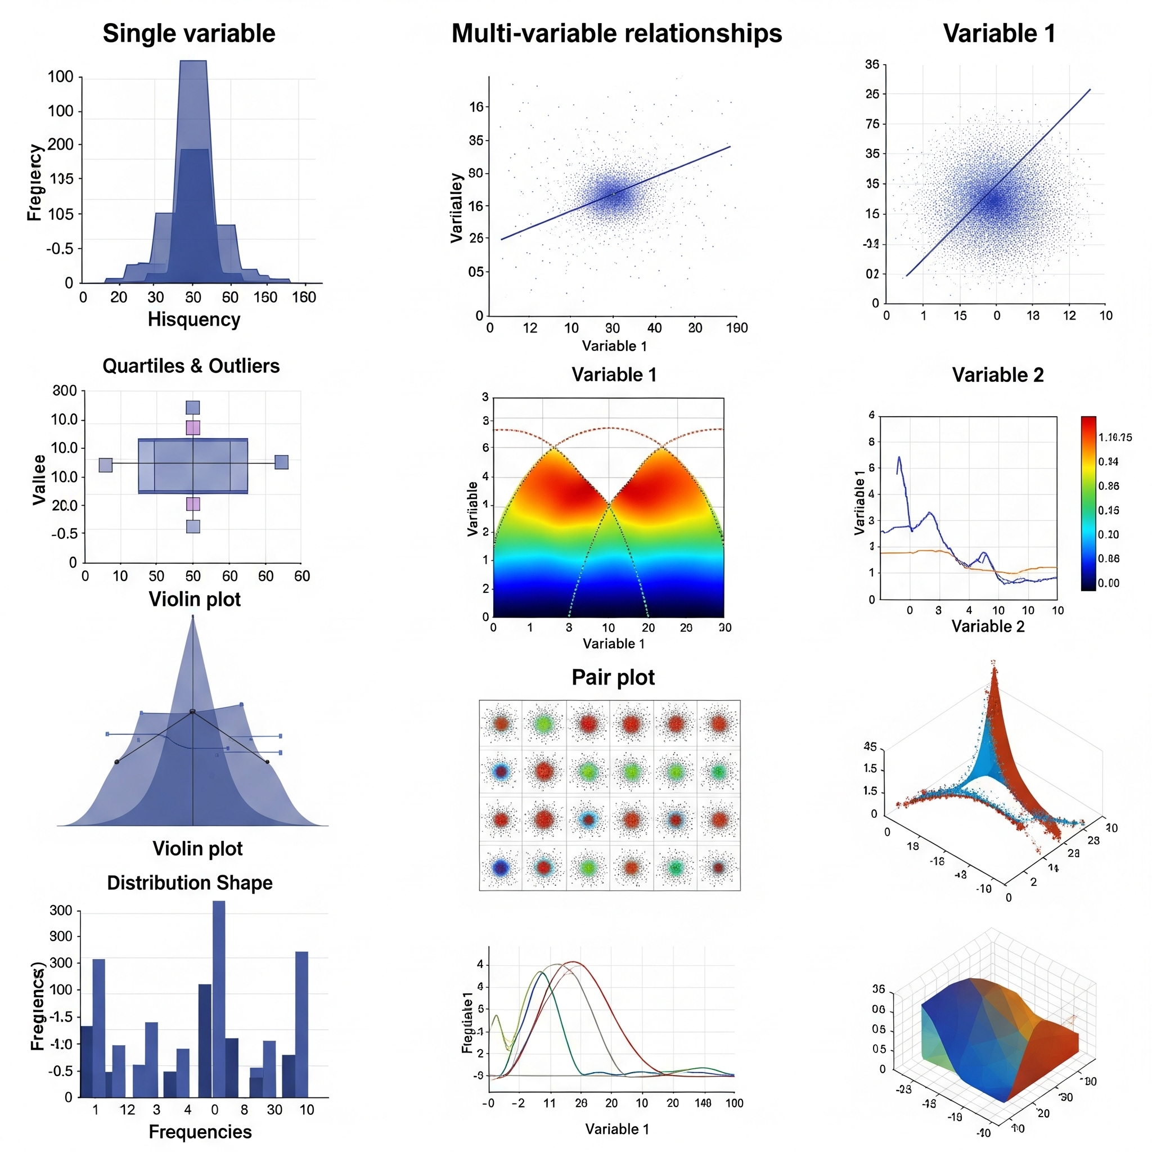
Types of EDA
Explore data with univariate non-graphical methods
Visualize single variables using univariate graphical analysis
Analyze relationships between variables with multivariate non-graphical
Display multi-variable relationships using multivariate graphical methods
Notes:
Univariate Non-Graphical Analysis: This is where we explore a single variable in our data without using any visual, so think your mean, mode median range, essentially your summary statistics. This gives a numerical snapshot of what the data looks like before we ever plot it.
Univariate Graphical Analysis: This still involves a single variable from the data but with the use of graphs. Common graphs include histograms, box plots, bar charts, and pie charts.
Multivariate Non-Graphical Analysis. The key point: Graphics show the story behind the summary statistics.
This involves analyzing two or more variables together without visuals but using numbers or tables instead. Common techniques include correlation coefficients, cross-tabulation, or summary statistics grouped by categories. It’s about moving from “what does one variable look like?” to “how do two or more variables interact .
Multivariate Graphical Analysis: This method uses visuals to show relationships among multiple variables at once. Common tools: scatter plots, heatmaps, pair plots, or 3D plots. This can This type of analysis helps us see complex relationships at a glance

Slide 5



Toolkit Used for Analysis
These are the three essential tools we'll use on our data investigation.
The Organiser
Lets us load, clean, and organize our data in tables (called DataFrames)
The Visualizer
Lets us load, clean, and organize our data in tables (called DataFrames)
Infographic Creator
Allows creation of beautiful, informative statistical graphics with much less code
Notes:
Read, slide

Slide 6
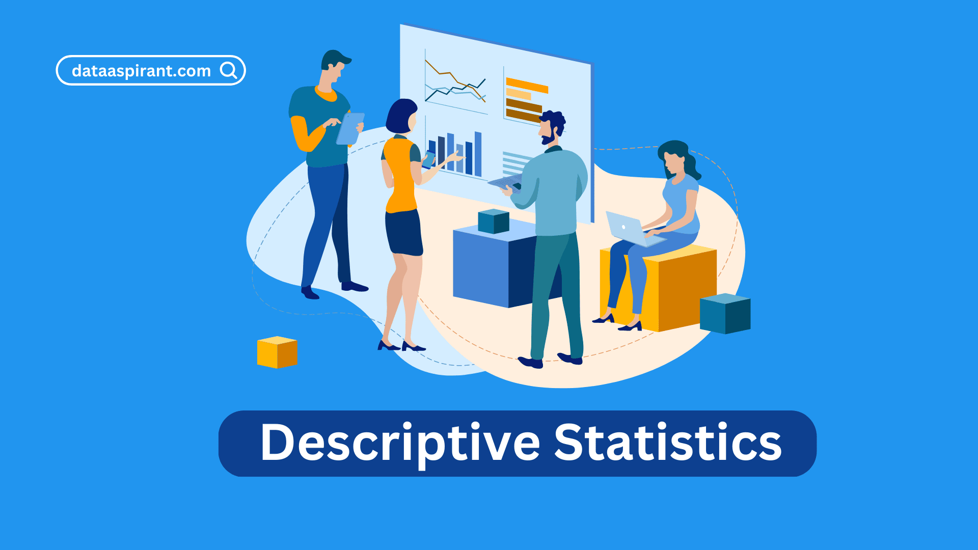
Descriptive Statistics
Establish fundamental facts before the big picture
Descriptive statistics summarize the dataset with single numbers
They help to understand the basic characteristics
Notes:
Before examining the big picture, we need to establish the fundamental facts. This is where descriptive statistics come in. They are single numbers that summarize our dataset.

Slide 7
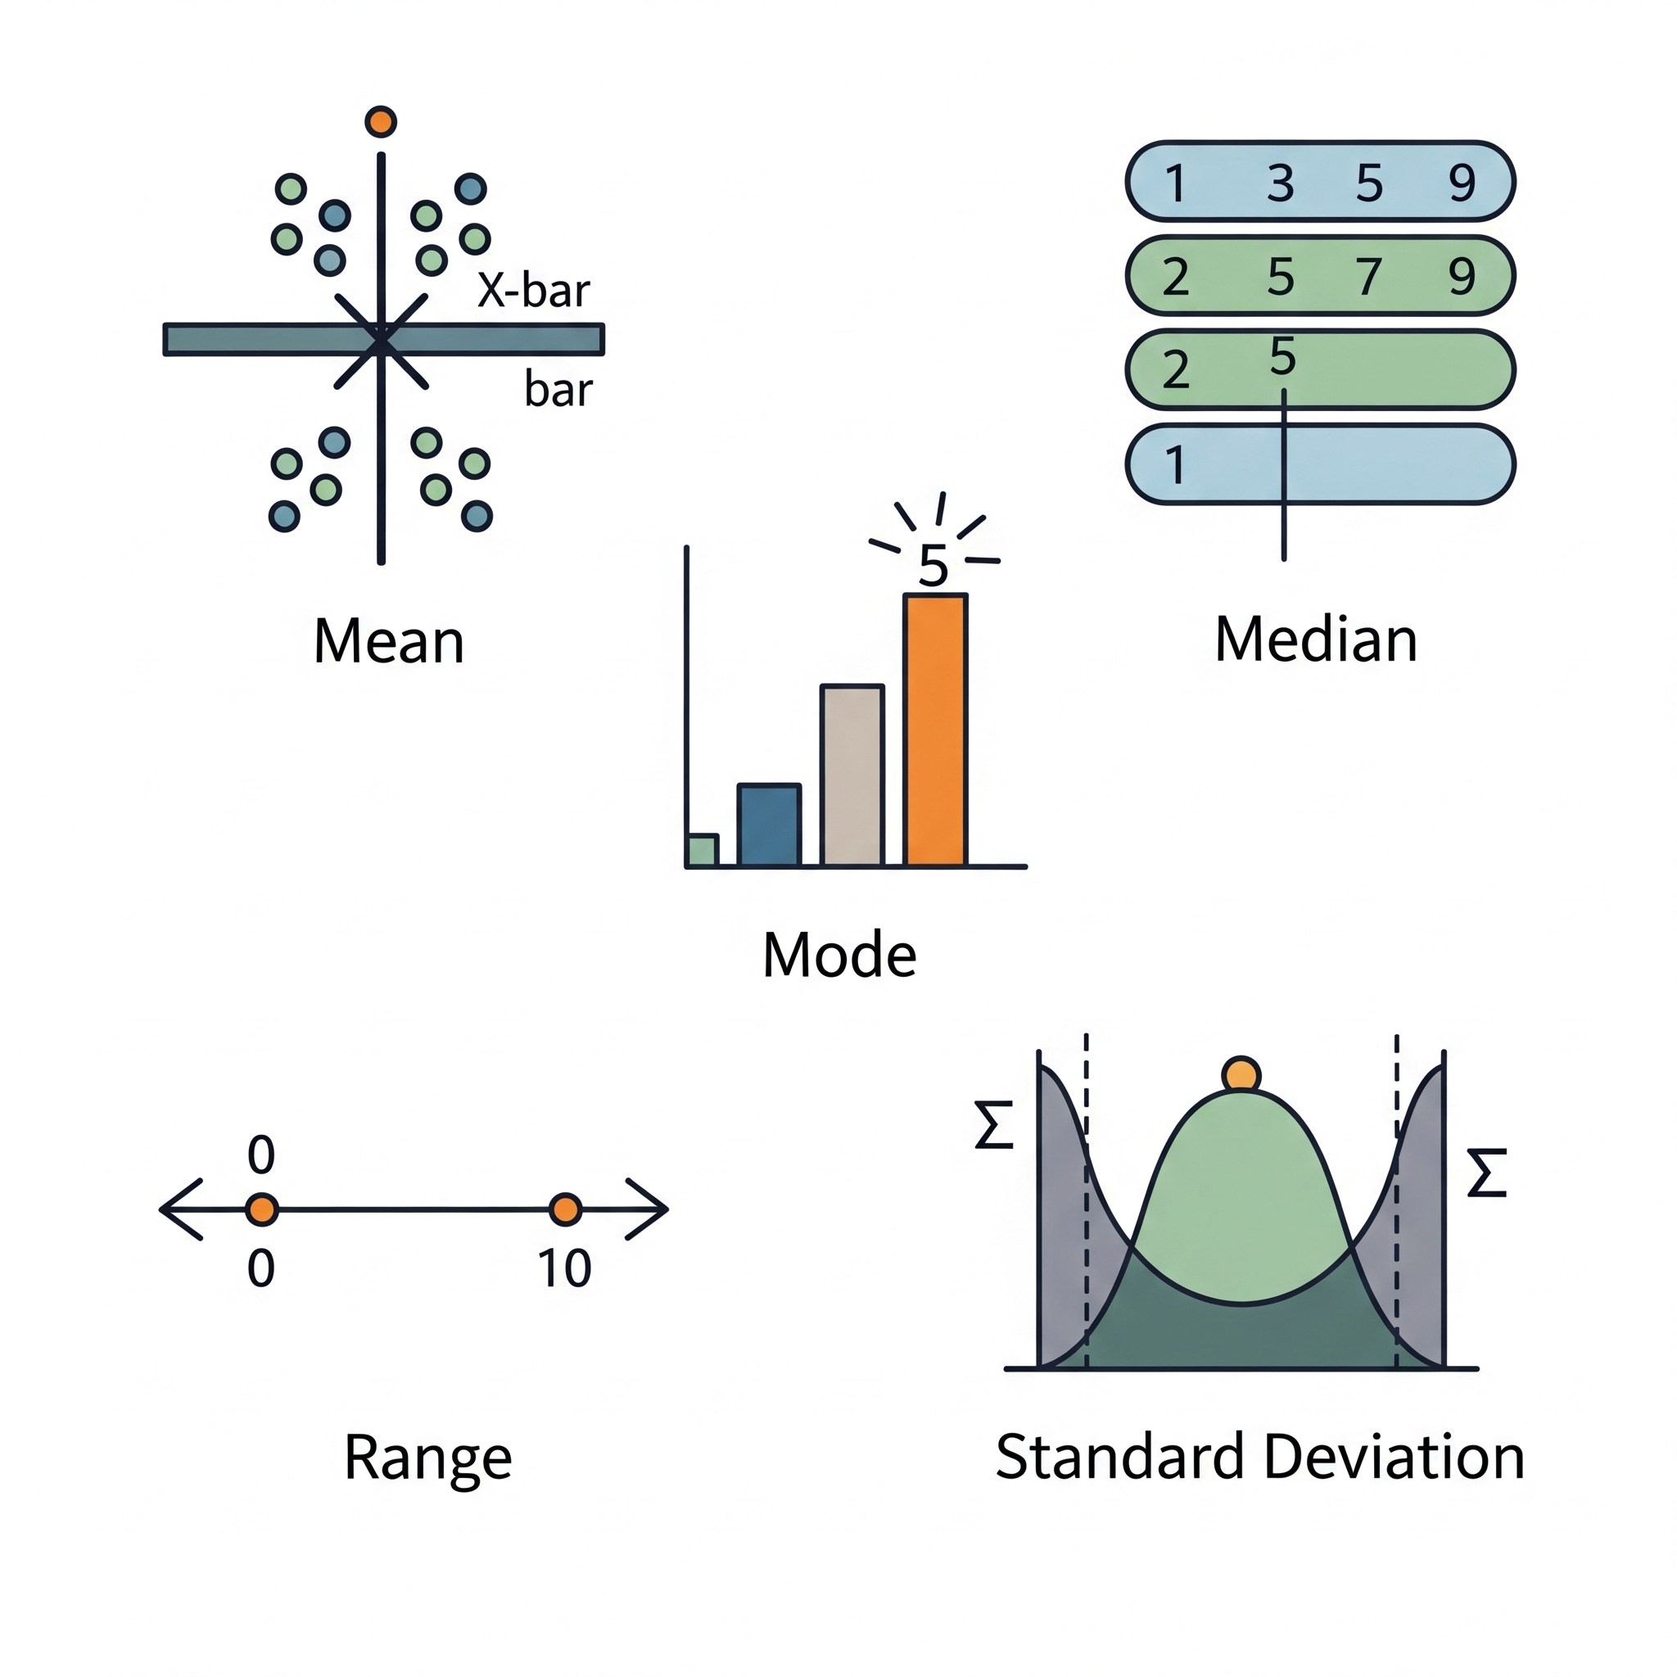
Descriptive Statistics with Pandas
Pandas is a Python library for data manipulation
Measures of Central Tendency :
Mean: The average value. Prone to being skewed by extreme outliers.
Median: The middle value when all data is sorted. It gives a better sense of the "typical" value when outliers are present.
Mode: The most frequently occurring value.
Measures of Spread:
Range: The difference between the highest and lowest values.
Standard Deviation: A measure of how spread out the data points are from the mean.
Notes:
Mean: The average value. Prone to being skewed by extreme outliers.
Range: The difference between the highest and lowest values.
Standard Deviation: A measure of how spread out the data points are from the mean. A low standard deviation indicates that the clues are clustered together; a high one means they are spread out.
Median: The middle value when all data is sorted. It gives a better sense of the "typical" value when outliers are present.
Mode: The most frequently occurring value.

Slide 8
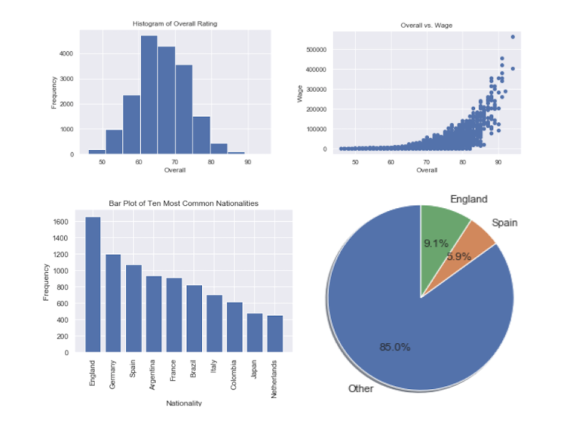
Visualization
Numbers are great, but our brains are wired for visuals.
Why visualize?
For example, a chart can reveal a pattern in an instant that would take hours to find in a spreadsheet.
Notes:
Numbers are great, but our brains are wired for visuals. A chart can reveal a pattern in an instant that would take hours to find in a spreadsheet. This is our clue board, where we connect the dots.

Slide 9


Our visualization tools
Matplotlib: This is a comprehensive library for creating static, animated, and interactive visualizations in Python.
Seaborn: Built on Matplotlib, is a Python data visualization library. It provides a high-level interface for drawing attractive and informative statistical graphics.
Notes:
Our visualization tools are:
Matplotlib: The foundational library. It's powerful and highly customizable—like a blank canvas.
Seaborn: Built on Matplotlib, Seaborn is like a professional charting toolkit. It creates beautiful, statistically-aware plots with less code.

Slide 10
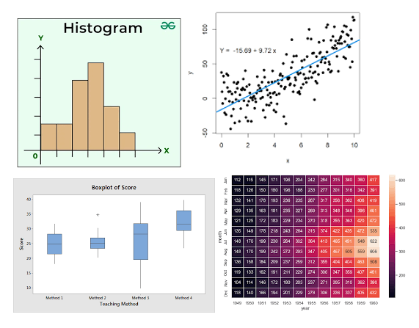
Key Visualization Types
Histogram: Shows the distribution of a single variable. (e.g., "How many passengers of each age group were on the Titanic?")
Scatter Plot: Reveals the relationship between two variables. (e.g., "Is there a connection between a passenger's age and the fare they paid?")
Boxplot: Perfect for identifying outliers (e.g., "Did a few passengers pay an extraordinarily high ticket fare?")
Heatmap: Excellent for seeing correlations between many variables at once. (e.g., "Which factors such as class, gender, or age are most strongly linked to survival?")

Slide 11
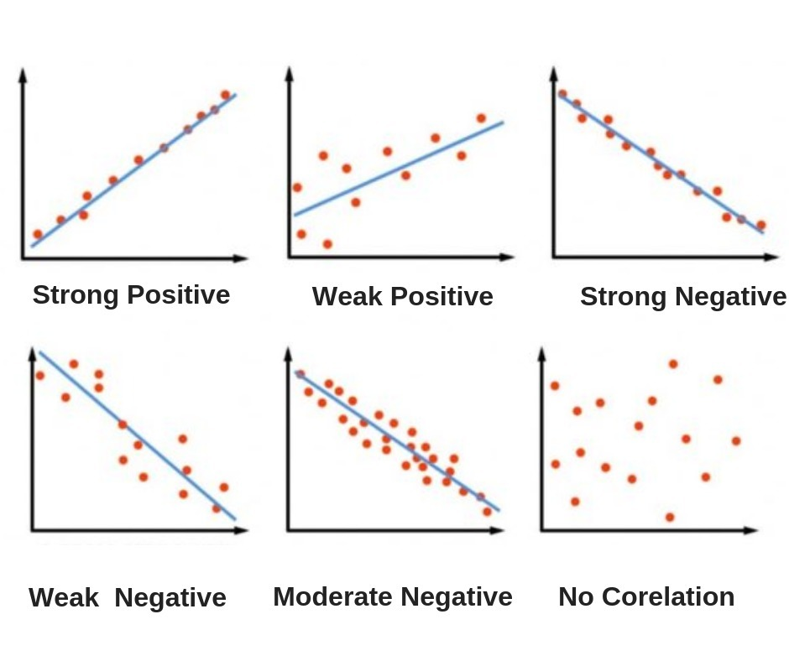
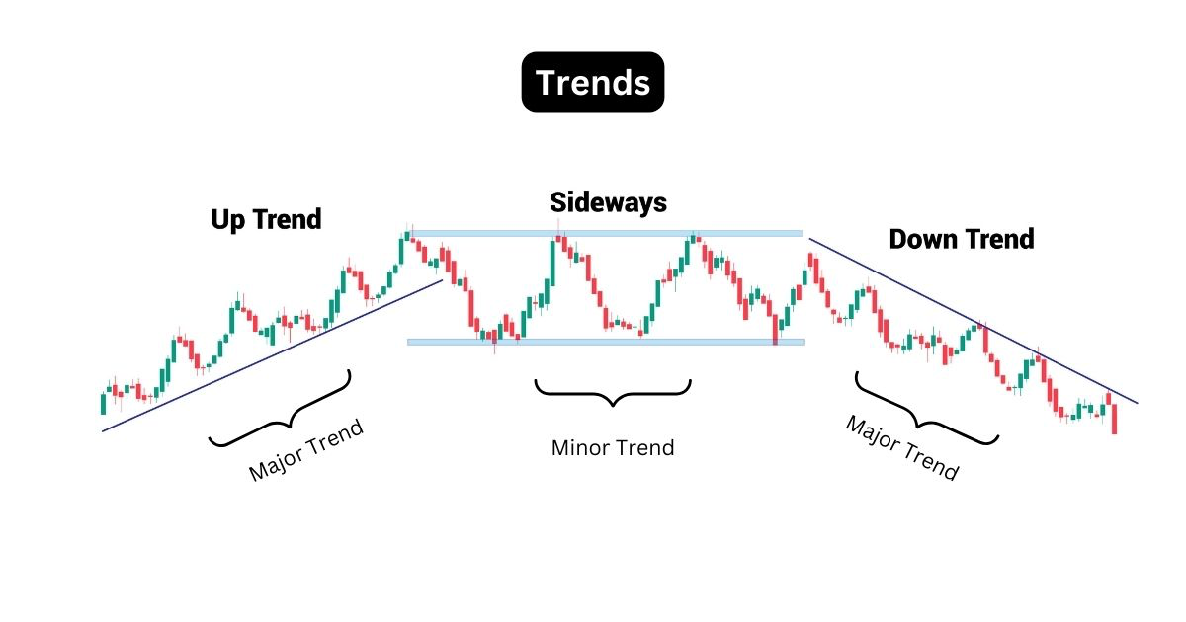
Trends in EDA
Trends show general directions or patterns in data over time or across categories.
Types of Trends include
Increasing/Decreasing
Seasonal/Cyclic
Correlations

Slide 12
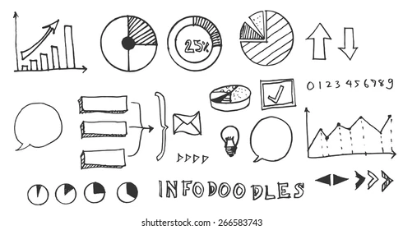
How to Identify Trends
Visualizations
- Line charts and Bar graphs for time series
- Scatter plots for correlations
- Heatmaps for variable relationships
Summary Statistics
Why It Matters
- Trends reveal predictable behavior in the data.
- Useful for forecasting, strategy, and spotting long-term patterns.

Slide 13
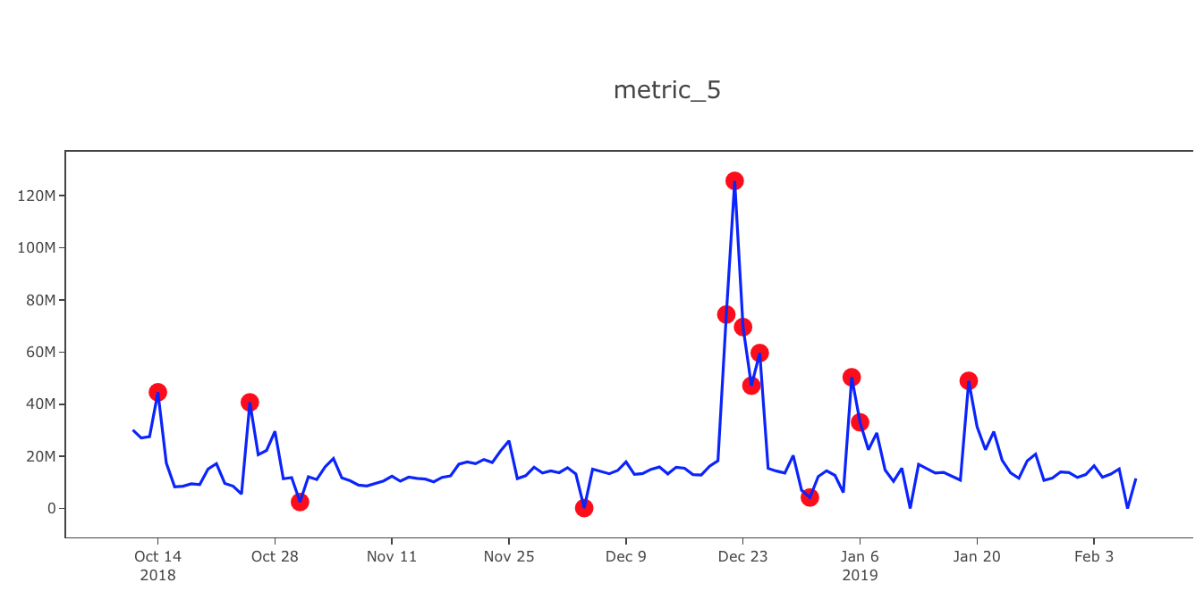
Anomalies in EDA
Anomalies (outliers) are unusual data points that don’t fit the overall trend.
Types of Anomalies
Point anomalies
Contextual anomalies
Collective anomalies

Slide 14
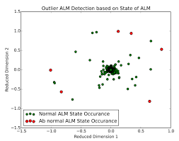
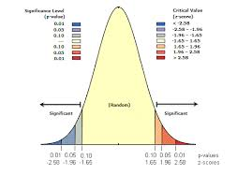
How to Detect Anomalies
Why It Matters
Anomalies can signal errors (bad data entry, system glitches) or insights (fraud, rare events, business opportunities).
Visualizations:
Boxplots
Scatter plots
Time series plots
Statistical Methods:
Z-scores or standard deviations
Interquartile range (IQR)
Distribution analysis

Slide 15
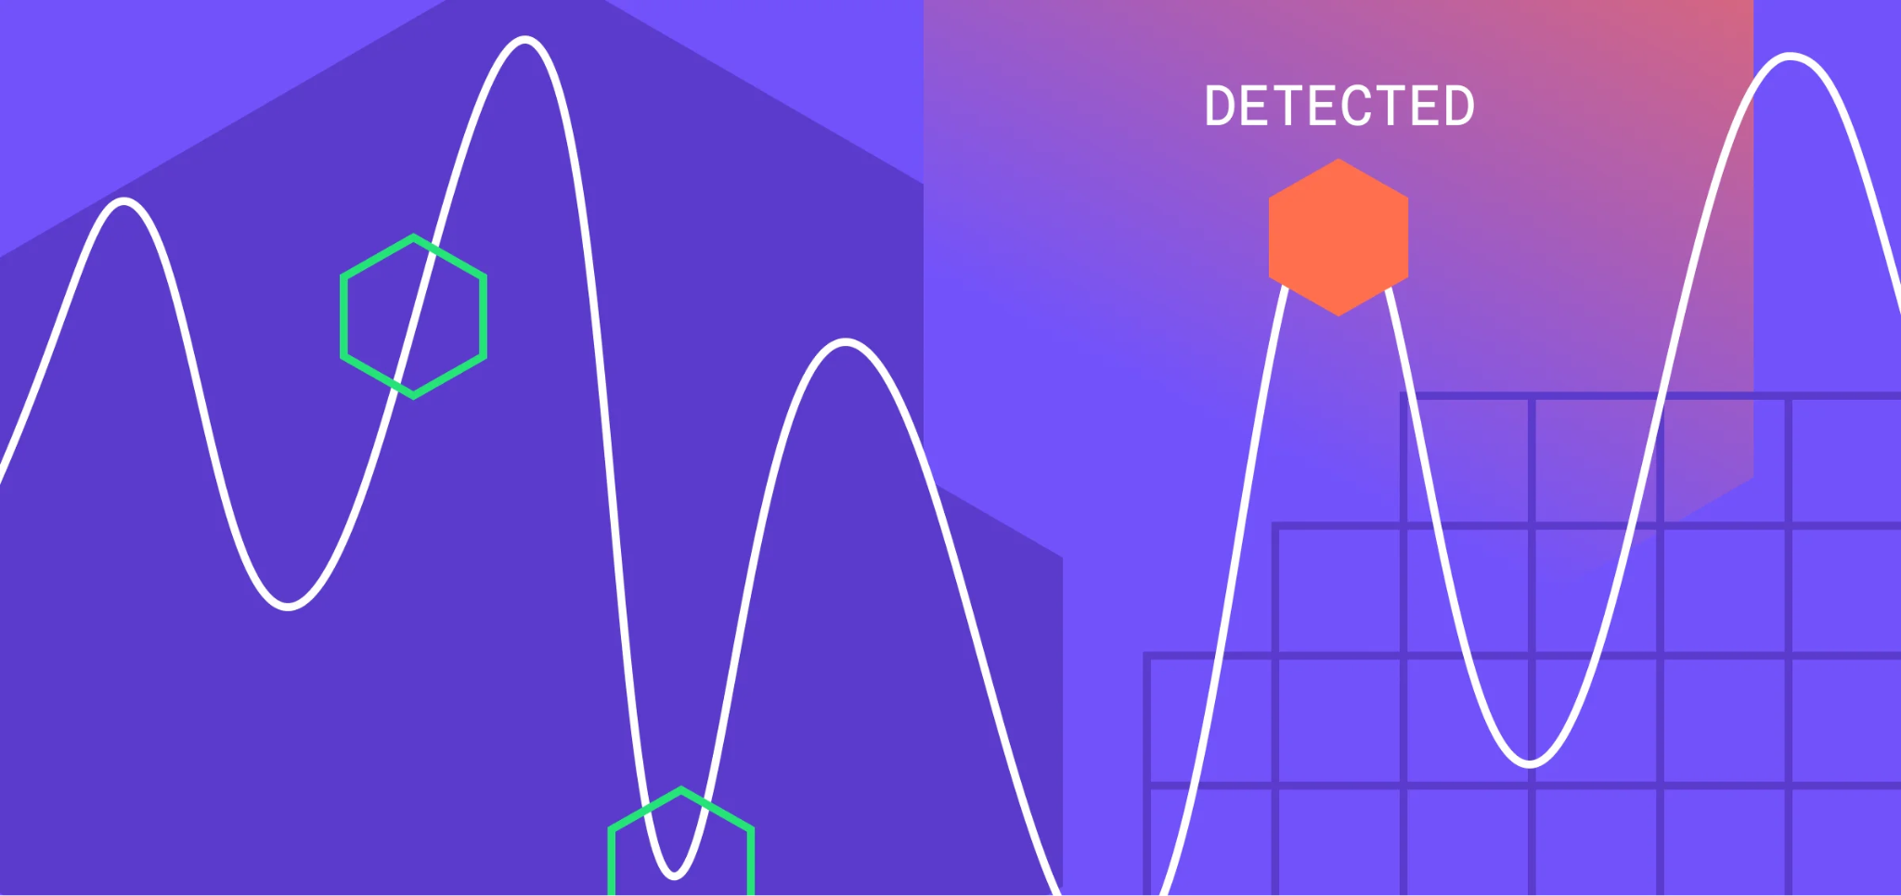
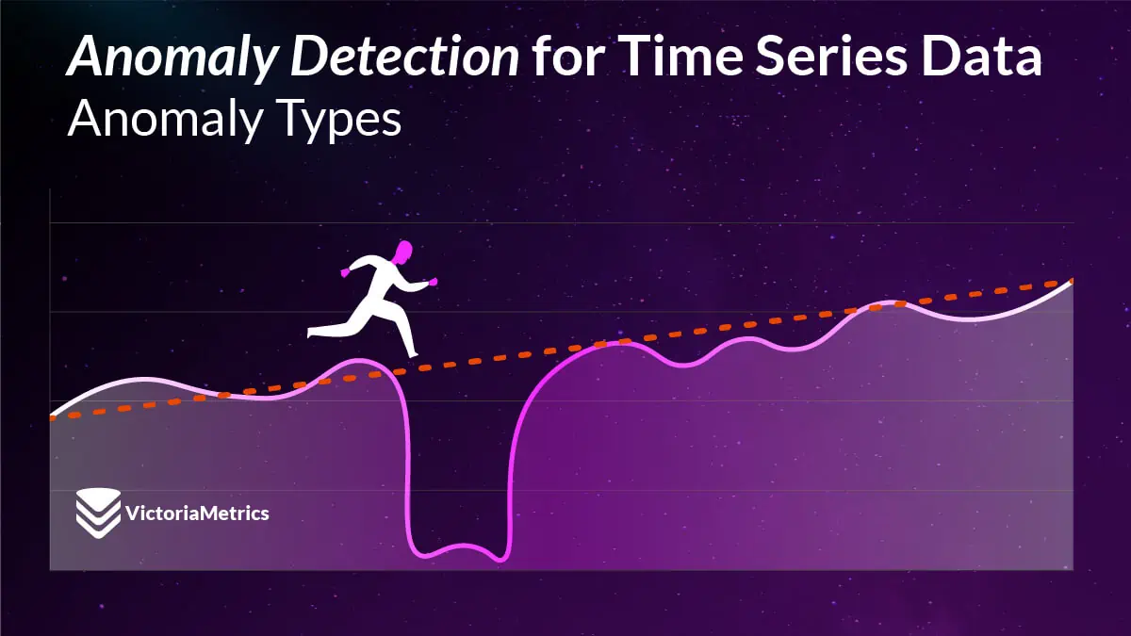
Balancing Trends and Anomalies
Trends show the "big picture", anomalies highlight the "unexpected details."
Both are essential:
Trends → help predict and plan
Anomalies → help investigate and improve

Slide 16
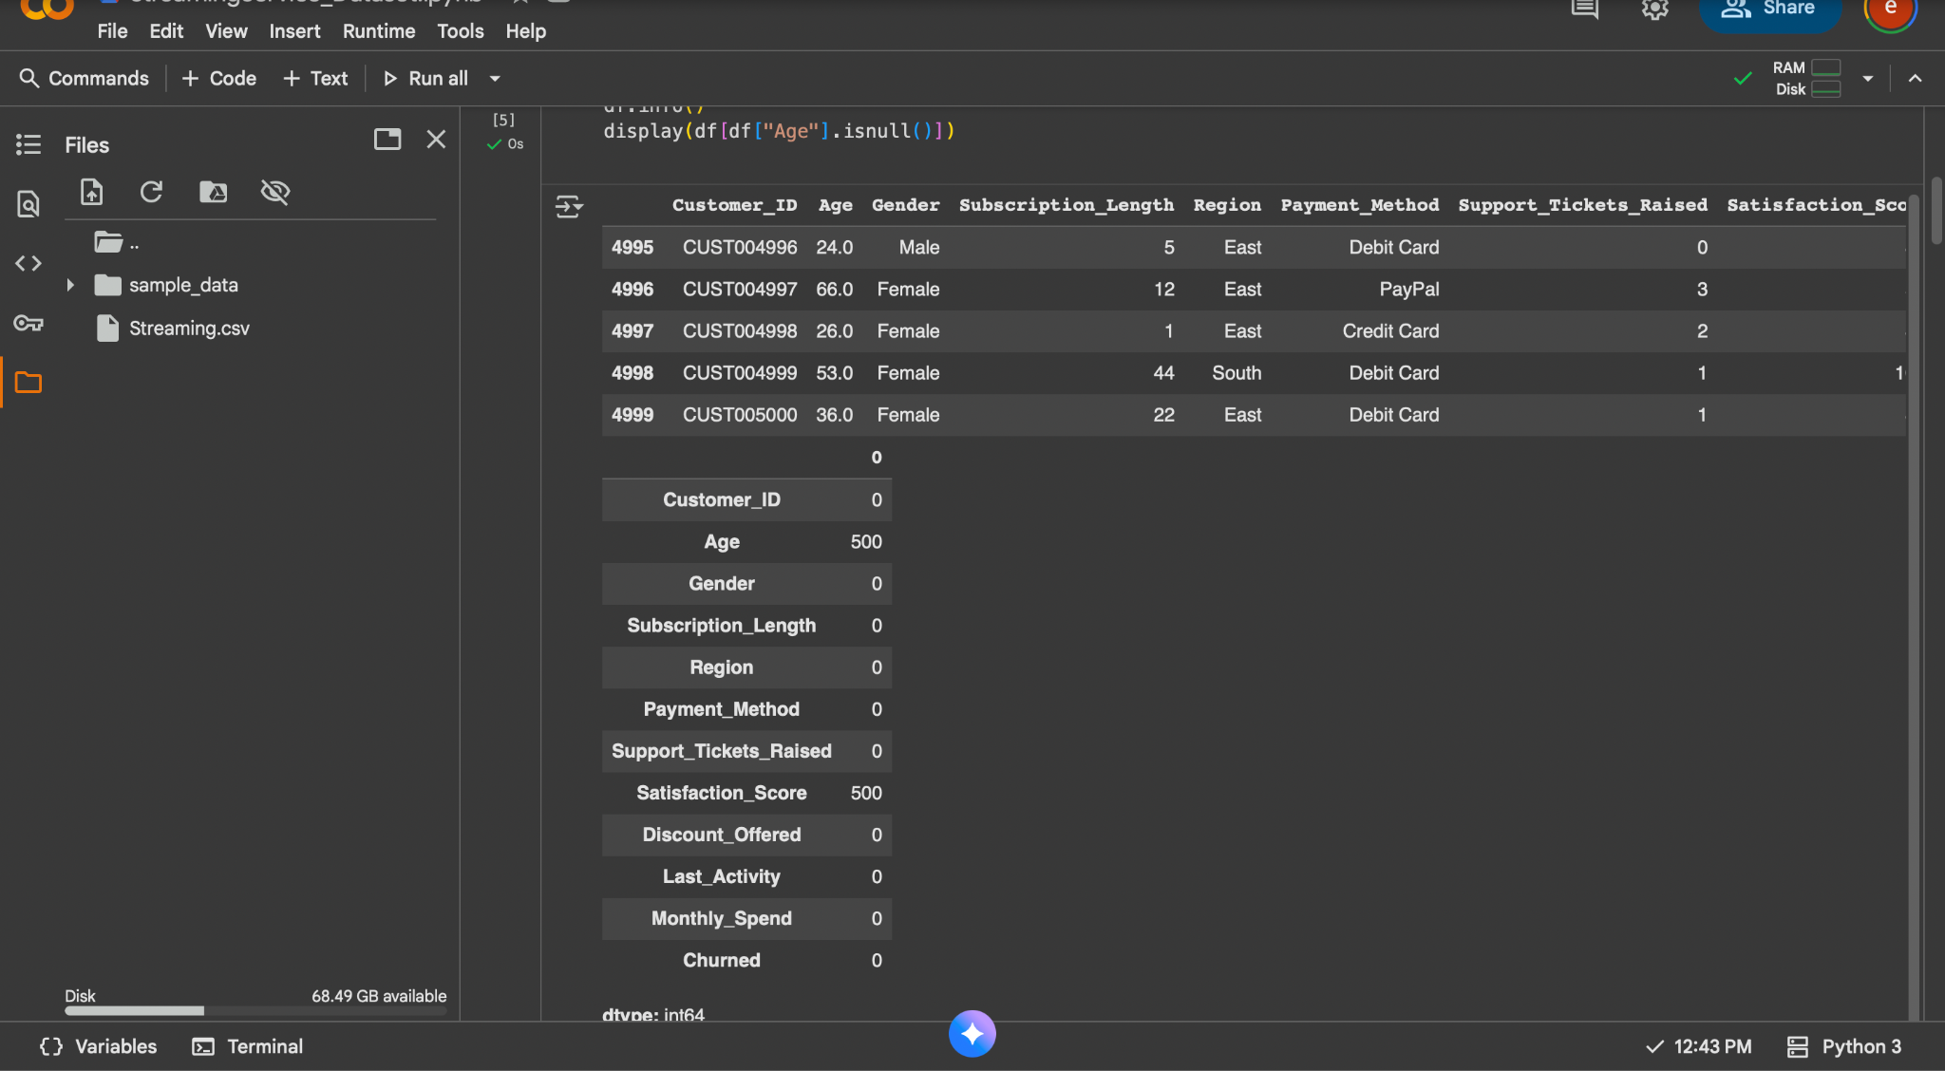
Dataset Intro

Slide 17
Conclusion
EDA is crucial for understanding data, revealing patterns, and identifying anomalies.
It involves summarizing characteristics, uncovering relationships, and spotting mistakes.
Key tools include descriptive statistics and various visualization methods like histograms and scatter plots.
Trends show predictable behavior, while anomalies highlight unexpected details.
Balancing both is essential for effective data analysis and informed decision-making.

Slide 18
Questions?

Slide 19
Work Cited
Tukey, John W. Exploratory Data Analysis. Addison-Wesley Pub. Co., 1977.
“What Is Exploratory Data Analysis (EDA)?” IBM, IBM Corporation, https://www.ibm.com/think/topics/exploratory-data-analysis. Accessed 15 Oct. 2025.
“What Is Exploratory Data Analysis?” GeeksforGeeks, Sanchhaya Education Pvt. Ltd., 14 Oct. 2025, https://www.geeksforgeeks.org/data-analysis/what-is-exploratory-data-analysis/. Accessed 15 Oct. 2025.

